Slide 1
Elevator Scheduling using Disk Scheduling Algorithm

Slide 2
Introduction
Elevator Scheduling works on Disk Scheduling Algorithm (SCAN).
According to SCAN Algorithm, the disk arm moves in a particular direction, and it reverses at the end.
Same method is followed in Elevator’s functionality.

Slide 3
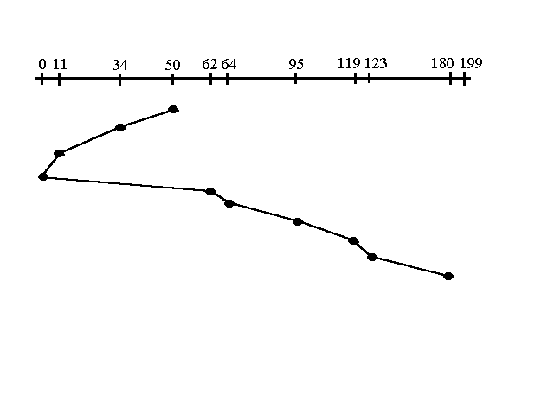
Working
Consider the elevator is on the 50th Floor.
Elevator’s first input is 34th Floor and it continues to
move towards ground floor(0th).
Then moves towards other end i.e. to 199th Floor.
This process in based on SCAN disk scheduling.

Slide 4
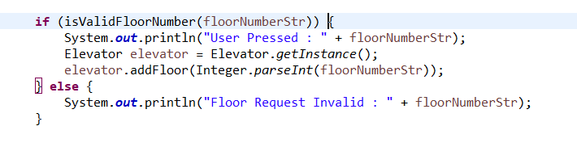
Working
Used Collection:
To check the floor is valid input:

Slide 5
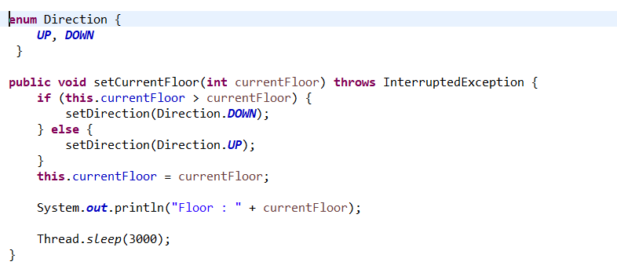
Working
Elevator moment from currentFloor:

Slide 6
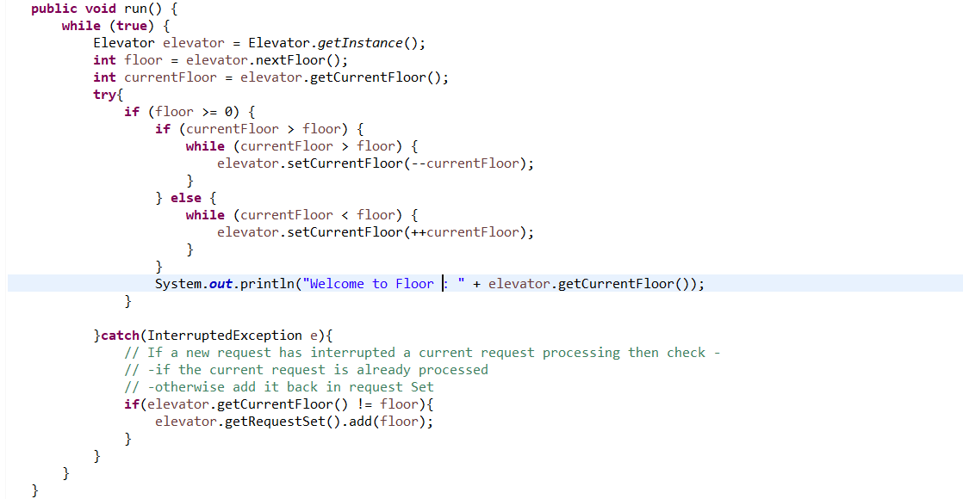
Working
The run method from Thread Class:

Slide 7
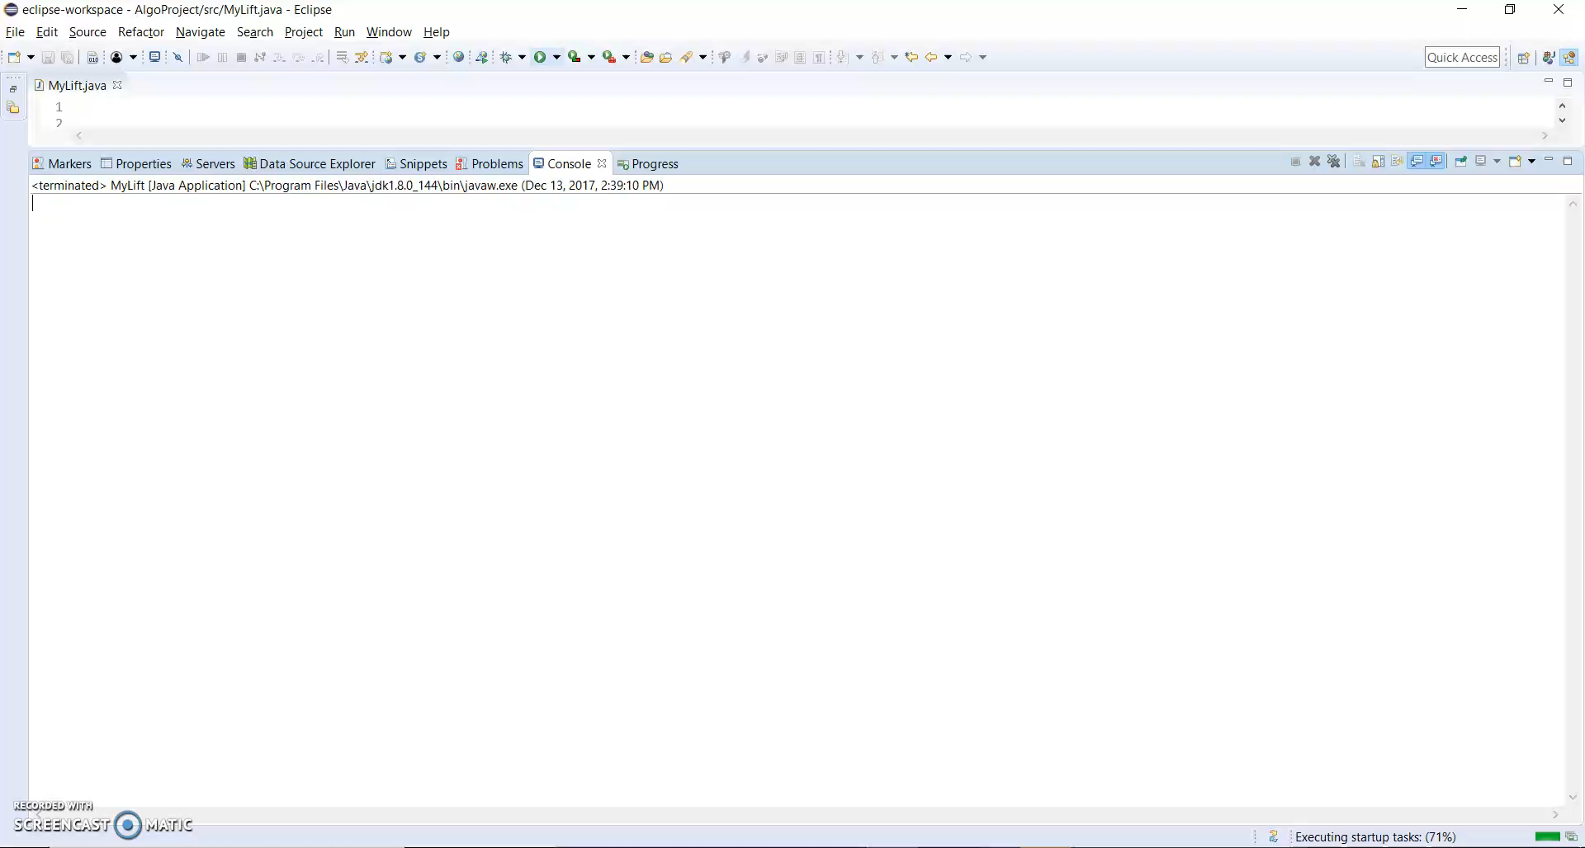
Video Demo

Slide 8
Thank You!

